Slide 1
Distributional Semantics - Introduction
Pawan Goyal
CSE, IIT Kharagpur
Week 7, Lecture 1
Distributional Semantics - Introduction
Week 7, Lecture 1

Slide 2
Introduction
What is Semantics?
The study of meaning: Relation between symbols and their denotata. John told Mary that the train moved out of the station at 3 o’clock.
Distributional Semantics - Introduction
Week 7, Lecture 1
2 / 14

Slide 3
Computational Semantics
Computational Semantics
The study of how to automate the process of constructing and reasoning with meaning representations of natural language expressions.
Methods in Computational Semantics generally fall in two categories: Formal Semantics: Construction of precise mathematical models of the relations between expressions in a natural language and the world.
John chases a bat → ∃x[bat(x) ∧ chase(john, x)]
Distributional Semantics: The study of statistical patterns of human word usage to extract semantics.
Distributional Semantics - Introduction
Week 7, Lecture 1
3 / 14

Slide 4
Distributional Hypothesis
Distributional Hypothesis: Basic Intuition
“The meaning of a word is its use in language.” (Wittgenstein, 1953)
“You know a word by the company it keeps.” (Firth, 1957)
→ Word meaning (whatever it might be) is reflected in linguistic distributions.
“Words that occur in the same contexts tend to have similar meanings.” (Zellig Harris, 1968)
→ Semantically similar words tend to have similar distributional patterns.
Distributional Semantics - Introduction
Week 7, Lecture 1
4 / 14

Slide 5
Distributional Semantics: a linguistic perspective
“If linguistics is to deal with meaning, it can only do so through distributional analysis.” (Zellig Harris)
“If we consider words or morphemes A and B to be more different in meaning than A and C, then we will often find that the distributions of A and B are more different than the distributions of A and C. In other words, difference in meaning correlates with difference of distribution.” (Zellig Harris, “Distributional Structure”)
Differential and not referential
Distributional Semantics - Introduction
Week 7, Lecture 1
5 / 14

Slide 6
Distributional Semantics: a cognitive perspective
Contextual representation
A word’s contextual representation is an abstract cognitive structure that accumulates from encounters with the word in various linguistic contexts.
We learn new words based on contextual cues
He filled the wampimuk with the substance, passed it around and we all drunk some.
We found a little wampimuk sleeping behind the tree.
Distributional Semantics - Introduction
Week 7, Lecture 1
6 / 14

Slide 7
Distributional Semantic Models (DSMs)
Computational models that build contextual semantic repesentations from corpus data
DSMs are models for semantic representations
⁾ The semantic content is represented by a vector
⁾ Vectors are obtained through the statistical analysis of the linguistic contexts of a word
Alternative names
⁾ corpus-based semantics
⁾ statistical semantics
⁾ geometrical models of meaning
⁾ vector semantics
⁾ word space models
Distributional Semantics - Introduction
Week 7, Lecture 1
7 / 14

Slide 8
Distributional Semantics: The general intuition
Distributions are vectors in a multidimensional semantic space, that is, objects with a magnitude and a direction.
The semantic space has dimensions which correspond to possible contexts, as gathered from a given corpus.
Distributional Semantics - Introduction
Week 7, Lecture 1

Slide 9
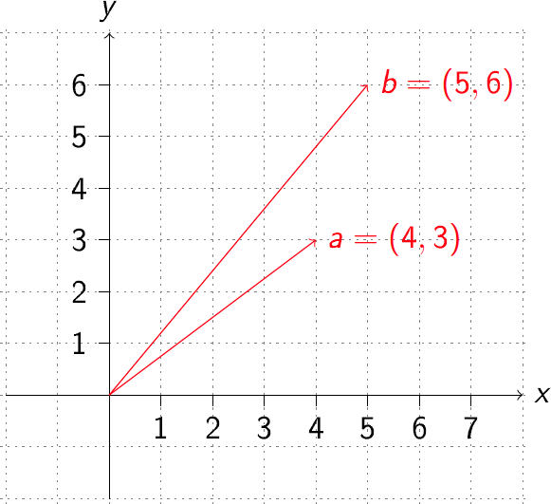
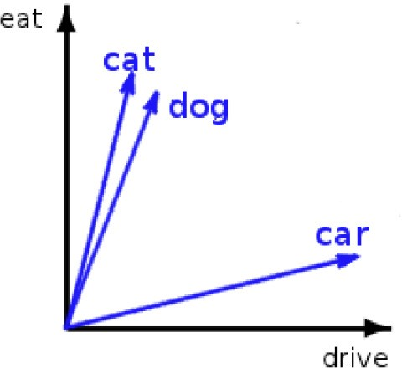
Vector Space
In practice, many more dimensions are used.
cat = [...dog 0.8, eat 0.7, joke 0.01, mansion 0.2,...]
Distributional Semantics - Introduction
Week 7, Lecture 1
9 / 14

Slide 10
Word Space
Small Dataset
An automobile is a wheeled motor vehicle used for transporting passengers .
A car is a form of transport , usually with four wheels and the capacity to carry around five passengers .
Transport for the London games is limited , with spectators strongly advised to avoid the use of cars .
The London 2012 soccer tournament began yesterday , with plenty of goals in the opening matches .
Giggs scored the first goal of the football tournament at Wembley , North London .
Bellamy was largely a passenger in the football match , playing no part in either goal .
Target words: ⟨automobile, car, soccer, football⟩
Term vocabulary : ⟨wheel, transport, passenger, tournament, London, goal, match⟩
Distributional Semantics - Introduction
Week 7, Lecture 1
10 / 14

Slide 11
Constructing Word spaces
Informal algorithm for constructing word spaces
Pick the words you are interested in: target words
Define a context window, number of words surrounding target word
⁾ The context can in general be defined in terms of documents, paragraphs or sentences.
Count number of times the target word co-occurs with the context words:
co-occurrence matrix
Build vectors out of (a function of) these co-occurrence counts
Distributional Semantics - Introduction
Week 7, Lecture 1
11 / 14

Slide 12
Constructing Word spaces: distributional vectors
distributional matrix = targets X contexts
 | wheel | transport | passenger | tournament | London | goal | match
automobile | 1 | 1 | 1 | 0 | 0 | 0 | 0
car | 1 | 2 | 1 | 0 | 1 | 0 | 0
soccer | 0 | 0 | 0 | 1 | 1 | 1 | 1
football | 0 | 0 | 1 | 1 | 1 | 2 | 1
Distributional Semantics - Introduction
Week 7, Lecture 1
12 / 14

Slide 13
2.5
² football (0,2)
1.5
goal
1 soccer (0,1)
0.5
automobile (1,0)
car (2,0)
0
0
0.5
1
transport
1.5
2
2.5
Distributional Semantics - Introduction
Week 7, Lecture 1
13 / 14

Slide 14
Computing similarity
 | wheel | transport | passenger | tournament | London | goal | match
automobile | 1 | 1 | 1 | 0 | 0 | 0 | 0
car | 1 | 2 | 1 | 0 | 1 | 0 | 0
soccer | 0 | 0 | 0 | 1 | 1 | 1 | 1
football | 0 | 0 | 1 | 1 | 1 | 2 | 1
Using simple vector product
automobile . car = 4
automobile . soccer = 0
automobile . football = 1
car . soccer = 1
car . football = 2
soccer . football = 5
Distributional Semantics - Introduction
Week 7, Lecture 1
14 / 14

Slide 15
Distributional Models of Semantics
Pawan Goyal
CSE, IIT Kharagpur
Week 7, Lecture 2
Distributional Models of Semantics
Week 7, Lecture 2

Slide 16
Vector Space Model without distributional similarity
Words are treated as atomic symbols
One-hot representation
Distributional Models of Semantics
Week 7, Lecture 2
2 / 19

Slide 17
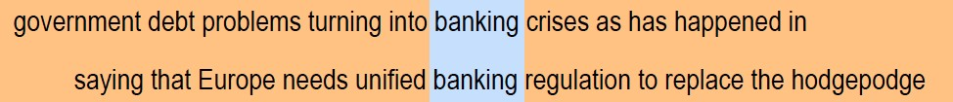
Distributional Similarity Based Representations
You know a word by the company it keeps
These words will represent banking
Distributional Models of Semantics
Week 7, Lecture 2
3 / 19

Slide 18
Building a DSM step-by-step
The “linguistic” steps
Pre-process a corpus (to define targets and contexts)
⇓
Select the targets and the contexts
The “mathematical” steps
Count the target-context co-occurrences
⇓
Weight the contexts (optional)
⇓
Build the distributional matrix
⇓
Reduce the matrix dimensions (optional)
⇓
Compute the vector distances on the (reduced) matrix
Distributional Models of Semantics
Week 7, Lecture 2
4 / 19

Slide 19
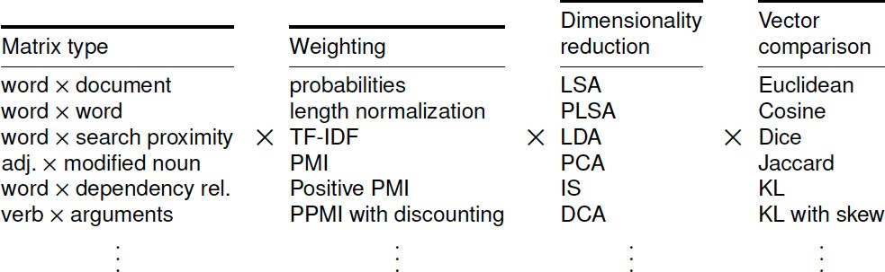
Many design choices
General Questions
How do the rows (words, ...) relate to each other?
How do the columns (contexts, documents, ...) relate to each other?
Distributional Models of Semantics
Week 7, Lecture 2
5 / 19

Slide 20
The parameter space
A number of parameters to be fixed
Which type of context? Which weighting scheme? Which similarity measure?
...
A specific parameter setting determines a particular type of DSM (e.g. LSA, HAL, etc.)
Distributional Models of Semantics
Week 7, Lecture 2

Slide 21
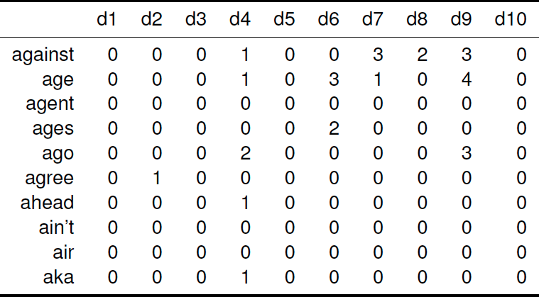
Documents as context: Word × document
Distributional Models of Semantics
Week 7, Lecture 2

Slide 22
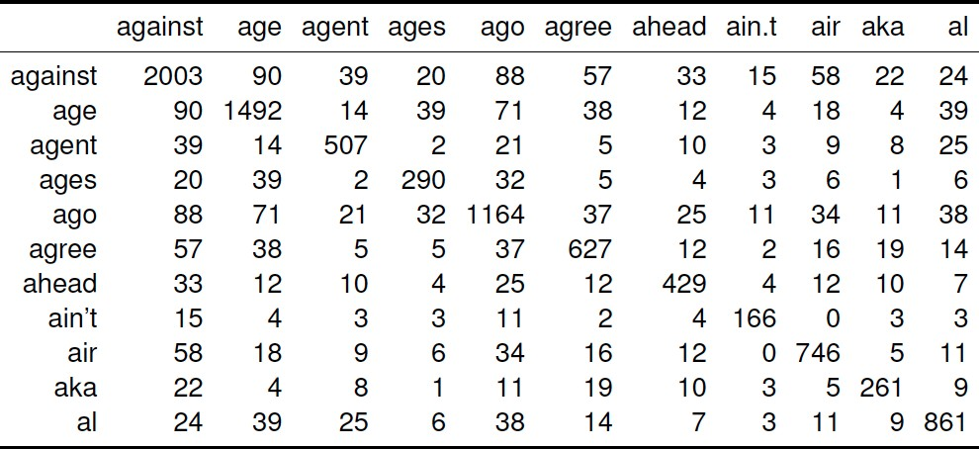
Words as context: Word × Word
Distributional Models of Semantics
Week 7, Lecture 2

Slide 23
Words as contexts
Parameters
Window size
Window shape - rectangular/triangular/other
5 words window (filtered): 2 words either side of the target word
Suspected communist rebels on 4 July 1989 killed Col. Herminio Taylo, police chief of Makati, the Philippines major financial center, in an escalation of street violence sweeping the Capitol area. The gunmen shouted references to the rebel New People’s Army. They fled in a commandeered passenger jeep. The military says communist rebels have killed up to 65 soldiers and police in the Capitol region since January.
Distributional Models of Semantics
Week 7, Lecture 2

Slide 24
Context weighting: documents as context
Indexing function F: Essential factors
Word frequency (f_{ij}): How many times a word appears in the document?
F ∝ f_{ij}
Document length (|D_{i}|): How many words appear in the document?
F ∝
1
|Di|
Document frequency (N_{j}): Number of documents in which a word
appears. F ∝ ¹
Nj
Indexing Weight: tf-Idf
N
f ∗ log( ) for each term, normalize the weight in a document with
ij
Nj
respect to L₂-norm.
Distributional Models of Semantics
Week 7, Lecture 2
10 / 19

Slide 25
Context weighting: words as context
basic intuition
word1 word2
freq(1,2)
freq(1)
freq(2)
dog dog
small domesticated
855 33,338 490,580
29 33,338 918
Distributional Models of Semantics
Week 7, Lecture 2
11 / 19

Slide 26
Context weighting: words as context
basic intuition
Association measures are used to give more weight to contexts that are more significantly associted with a targer word.
The less frequent the target and context element are, the higher the weight given to their co-occurrence count should be.
⇒ Co-occurrence with frequent context element small is less informative than co-occurrence with rarer domesticated.
different measures - e.g., Mutual information, Log-likelihood ratio
Distributional Models of Semantics
Week 7, Lecture 2
11 / 19

Slide 27
Pointwise Mutual Information (PMI)
PMI(w₁, w₂) = log₂ ^{Pcorpus(w1, w2)}
P_{ind} (w₁, w₂)
PMI(w₁, w₂) = log₂ ^{Pcorpus(w1, w2)}
Pcorpus(w1)Pcorpus(w2)
_{Pcorpus(w1, w2) =} freq(w₁, w₂)
N
_{Pcorpus(w) =} freq(w)
N
Distributional Models of Semantics
Week 7, Lecture 2
12 / 19

Slide 28
PMI: Issues and Variations
Positive PMI
All PMI values less than zero are replaced with zero.
Bias towards infrequent events
Consider w_{j} having the maximum association with w_{i}, Pcorpus(wi) ≈ Pcorpus(wj) ≈ Pcorpus(wi, wj)
PMI increases as the probability of w_{i} decreases.
Also, consider a word w_{j} that occurs once in the corpus, also in the context of
w_{i}. A discounting factor proposed by Pantel and Lin:
_{δij =} f_{ij} min(f_{i}, f_{j})
f_{ij} + 1 min(f_{i}, f_{j}) + 1
PMI_{new}(w_{i}, w_{j}) = δ_{ij}PMI(w_{i}, w_{j})
Distributional Models of Semantics
Week 7, Lecture 2
13 / 19

Slide 29
Distributional Vectors: Example
Normalized Distributional Vectors using Pointwise Mutual Information
petroleum | oil:0.032 gas:0.029 crude:0.029 barrels:0.028 exploration:0.027 barrel:0.026 opec:0.026 refining:0.026 gasoline:0.026 fuel:0.025 natural:0.025 exporting:0.025
drug | trafficking:0.029 cocaine:0.028 narcotics:0.027 fda:0.026 police:0.026 abuse:0.026 marijuana:0.025 crime:0.025 colombian:0.025 arrested:0.025 addicts:0.024
insurance | insurers:0.028 premiums:0.028 lloyds:0.026 reinsurance:0.026 underwriting:0.025 pension:0.025 mortgage:0.025 credit:0.025 investors:0.024 claims:0.024 benefits:0.024
forest | timber:0.028 trees:0.027 land:0.027 forestry:0.026 environmental:0.026 species:0.026 wildlife:0.026 habitat:0.025 tree:0.025 mountain:0.025 river:0.025 lake:0.025
robotics | robots:0.032 automation:0.029 technology:0.028 engineering:0.026 systems:0.026 sensors:0.025 welding:0.025 computer:0.025 manufacturing:0.025 automated:0.025
Distributional Models of Semantics
Week 7, Lecture 2
14 / 19

Slide 30
Distributional Semantics: Applications, Structured Models
Pawan Goyal
CSE, IIT Kharagpur
Week 7, Lecture 3
Distributional Semantics: Applications, Structured
Week 7, Lecture 3

Slide 31
Application to Query Expansion: Addressing Term Mismatch
Term Mismatch Problem in Information Retrieval
Stems from the word independence assumption during document indexing. User query: insurance cover which pays for long term care.
A relevant document may contain terms different from the actual user query. Some relevant words concerning this query: {medicare, premiums, insurers}
Using DSMs for Query Expansion
Given a user query, reformulate it using related terms to enhance the retrieval performance.
The distributional vectors for the query terms are computed.
Expanded query is obtained by a linear combination or a functional combination of these vectors.
Distributional Semantics: Applications, Structured
Week 7, Lecture 3
2 / 15

Slide 32
Query Expansion using Unstructured DSMs
TREC Topic 104: catastrophic health insurance
Query Representation: surtax:1.0 hcfa:0.97 medicare:0.93 hmos:0.83 medicaid:0.8 hmo:0.78 beneficiaries:0.75 ambulatory:0.72 premiums:0.72 hospitalization:0.71 hhs:0.7 reimbursable:0.7 deductible:0.69
Broad expansion terms: medicare, beneficiaries, premiums . . .
Specific domain terms: HCFA (Health Care Financing Administration), HMO
(Health Maintenance Organization), HHS (Health and Human Services)
TREC Topic 355: ocean remote sensing
Query Representation: radiometer:1.0 landsat:0.97 ionosphere:0.94 cnes:0.84 altimeter:0.83 nasda:0.81 meterology:0.81 cartography:0.78 geostationary:0.78 doppler:0.78 oceanographic:0.76
Broad expansion terms: radiometer, landsat, ionosphere . . .
Specific domain terms: CNES (Centre National dÉtudes Spatiales) and NASDA
(National Space Development Agency of Japan)
Distributional Semantics: Applications, Structured
Week 7, Lecture 3
3 / 15

Slide 33
Similarity Measures for Binary Vectors
Let X and Y denote the binary distributional vectors for words X and Y.
Similarity Measures
Dice coefficient : ^{2|X∩Y|}
|X|+|Y|
Jaccard Coefficient : ^{|X∩Y|}
|X∪Y|
Overlap Coefficient : _{min}^{|X∩Y|}
(|X|,|Y|)
Jaccard coefficient penalizes small number of shared entries, while Overlap coefficient uses the concept of inclusion.
Distributional Semantics: Applications, Structured
Week 7, Lecture 3
4 / 15

Slide 34
Similarity Measures for Vector Spaces
Let →X and →Y denote the distributional vectors for words X and Y.
→X = [x₁, x₂, . . . , x_{n}], →Y = [y₁, y₂, . . . , y_{n}]
Similarity Measures
Cosine similarity : cos(→X,→Y) = ^{X¯·→Y}
√
|→X||→Y|
→ →
n
Euclidean distance : |X − Y| = Σ (x_{i} − y_{i})²
i=1
Distributional Semantics: Applications, Structured
Week 7, Lecture 3
5 / 15

Slide 35
Similarity Measure for Probability Distributions
Let p and q denote the probability distributions corresponding to two distributional vectors.
Similarity Measures
KL-divergence : D(p||q) = Σ p log
p
i i
i
qi
p+q
p+q
Information Radius : D(p|| ) + D
(q|| )
2
2
L₁-norm : Σ_{i}|p_{i} − q_{i}|
Distributional Semantics: Applications, Structured
Week 7, Lecture 3
6 / 15

Slide 36
Attributional Similarity vs. Relational Similarity
Attributional Similarity
The attributional similarity between two words a and b depends on the degree of correspondence between the properties of a and b.
Ex: dog and wolf
Relational Similarity
Two pairs(a, b) and (c, d) are relationally similar if they have many similar relations.
Ex: dog: bark and cat: meow
Distributional Semantics: Applications, Structured
Week 7, Lecture 3

Slide 37
Relational Similarity: Pair-pattern matrix
Pair-pattern matrix
Row vectors correspond to pairs of words, such as mason: stone and
carpenter: wood
Column vectors correspond to the patterns in which the pairs occur, e.g.
X cuts Y and X works with Y
Compute the similarity of rows to find similar pairs
Extended Distributional Hypothesis; Lin and Pantel
Patterns that co-occur with similar pairs tend to have similar meanings.
This matrix can also be used to measure the semantic similarity of patterns.
Given a pattern such as “X solves Y”, you can use this matrix to find similar patterns, such as “Y is solved by X”, “Y is resolved in X”, “X resolves Y”.
Distributional Semantics: Applications, Structured
Week 7, Lecture 3
8 / 15

Slide 38
Structured DSMs
Basic Issue
Words may not be the basic context units anymore
How to capture and represent syntactic information?
X solves Y and Y is solved by X
An Ideal Formalism
Should mirror semantic relationships as close as possible
Incorporate word-based information and syntactic analysis Should be applicable to different languages
Use Dependency grammar framework
Distributional Semantics: Applications, Structured
Week 7, Lecture 3
9 / 15

Slide 39
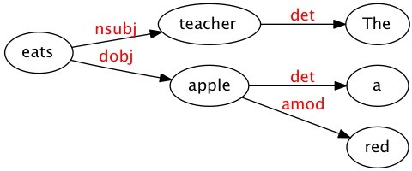
Structured DSMs
Using Dependency Structure: How does it help?
The teacher eats a red apple.
‘eat’ is not a legitimate context for ‘red’.
The ‘object’ relation connecting ‘eat’ and ‘apple’ is treated as a different type of co-occurrence from the ‘modifier’ relation linking ‘red’ and ‘apple’.
Distributional Semantics: Applications, Structured
Week 7, Lecture 3
10 / 15

Slide 40
Structured DSMs
Structured DSMs: Words as ‘legitimate’ contexts
Co-occurrence statistics are collected using parser-extracted relations.
To qualify as context of a target item, a word must be linked to it by some (interesting) lexico-syntactic relation
Distributional Semantics: Applications, Structured
Week 7, Lecture 3
11 / 15

Slide 41
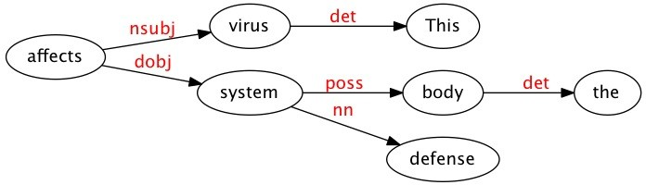
Structured DSMs
Distributional models, as guided by dependency
Ex: For the sentence ‘This virus affects the body’s defense system.’, the dependency parse is:
Word vectors
<system, dobj, affects> ...
Corpus-derived ternary data can also be mapped onto a 2-way matrix
Distributional Semantics: Applications, Structured
Week 7, Lecture 3
12 / 15

Slide 42
2-way matrix
<system, dobj, affects>
<virus, nsubj, affects>
The dependency information can be dropped
<system, dobj, affects> ⇒ <system, affects>
<virus, nsubj, affects> ⇒ <virus, affects>
Link and one word can be concatenated and treated as attributes
virus={nsubj-affects:0.05,...}, system={dobj-affects:0.03,...}
Distributional Semantics: Applications, Structured
Week 7, Lecture 3
13 / 15

Slide 43
Structured DSMs for Selectional Preferences
Selectional Preferences for Verbs
Most verbs prefer arguments of a particular type. This regularity is known as selectional preference.
From a parsed corpus, noun vectors are calculated as shown for ‘virus’ and ‘system’.
obj-carry 0.1
obj-buy 0.4
obj-drive 0.8
obj-eat 0.02
obj-store sub-fly . . .
0.2 0.05 . . .
. . .
. . .
. . .
car vegetable biscuit
· · ·
0.3
0.4
. . .
0.5
0.4
. . .
0
0
. . .
0.6
0.5
. . .
0.3
0.4
. . .
0.05
0.02
. . .
Distributional Semantics: Applications, Structured
Week 7, Lecture 3
14 / 15

Slide 44
Structured DSMs for Selectional Preferences
Selectional Preferences
Suppose we want to compute the selectional preferences of the nouns as object of verb ‘eat’.
n nouns having highest weight in the dimension ‘obj-eat’ are selected, let
{vegetable, biscuit,. . .} be the set of these n nouns.
The complete vectors of these n nouns are used to obtain an ‘object prototype’ of the verb.
‘object prototype’ will indicate various attributes such as these nouns can be consumed, bought, carried, stored etc.
Similarity of a noun to this ‘object prototype’ is used to denote the plausibility of that noun being an object of verb ‘eat’.
Distributional Semantics: Applications, Structured
Week 7, Lecture 3
15 / 15

Slide 45
Word Embeddings - Part I
Pawan Goyal
CSE, IIT Kharagpur
Week 7, Lecture 4
Word Embeddings - Part I
Week 7, Lecture 4

Slide 46
Word Vectors
At one level, it is simply a vector of weights.
In a simple 1-of-N (or ‘one-hot’) encoding every element in the vector is associated with a word in the vocabulary.
The encoding of a given word is simply the vector in which the corresponding element is set to one, and all other elements are zero.
One-hot representation
Word Embeddings - Part I
Week 7, Lecture 4
2 / 19

Slide 47
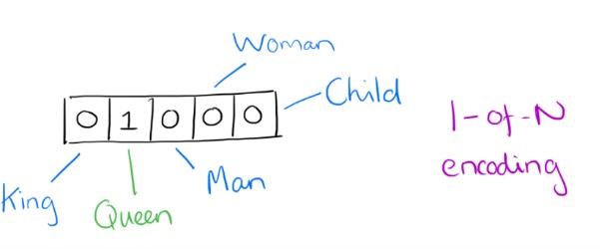
Word Vectors - One-hot Encoding
Suppose our vocabulary has only five words: King, Queen, Man, Woman, and Child.
We could encode the word ‘Queen’ as:
Word Embeddings - Part I
Week 7, Lecture 4

Slide 48
Limitations of One-hot encoding
Word vectors are not comparable
Using such an encoding, there is no meaningful comparison we can make between word vectors other than equality testing.
Word Embeddings - Part I
Week 7, Lecture 4
4 / 19

Slide 49
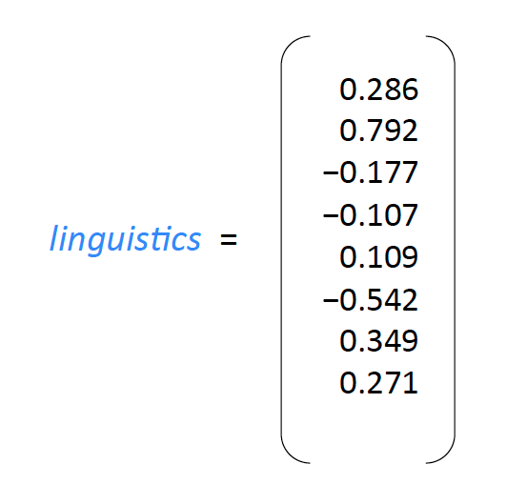
Word2Vec – A distributed representation
Distributional representation – word embedding?
Any word w_{i} in the corpus is given a distributional representation by an embedding
w_{i} ∈ R^{d}
i.e., a d−dimensional vector, which is mostly learnt!
Word Embeddings - Part I
Week 7, Lecture 4
5 / 19

Slide 50
Distributional Representation
Take a vector with several hundred dimensions (say 1000).
Each word is represented by a distribution of weights across those elements.
So instead of a one-to-one mapping between an element in the vector and a word, the representation of a word is spread across all of the elements in the vector, and
Each element in the vector contributes to the definition of many words.
Word Embeddings - Part I
Week 7, Lecture 4

Slide 51
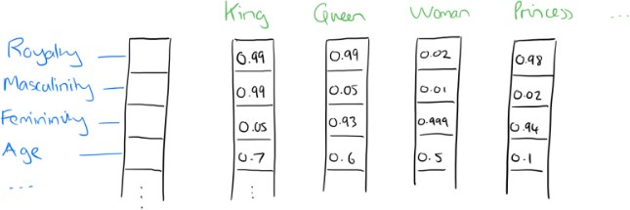
Distributional Representation: Illustration
If we label the dimensions in a hypothetical word vector (there are no such pre-assigned labels in the algorithm of course), it might look a bit like this:
Such a vector comes to represent in some abstract way the ‘meaning’ of a word
Word Embeddings - Part I
Week 7, Lecture 4

Slide 52
Word Embeddings
d typically in the range 50 to 1000
Similar words should have similar embeddings
SVD can also be thought of as an embedding method
Word Embeddings - Part I
Week 7, Lecture 4
8 / 19

Slide 53
Reasoning with Word Vectors
It has been found that the learned word representations in fact capture meaningful syntactic and semantic regularities in a very simple way.
Specifically, the regularities are observed as constant vector offsets between pairs of words sharing a particular relationship.
Case of Singular-Plural Relations
If we denote the vector for word i as x_{i}, and focus on the singular/plural relation, we observe that
xapple − xapples ≈ xcar − xcars ≈ xfamily − xfamilies ≈ xcar − xcars
and so on.
Word Embeddings - Part I
Week 7, Lecture 4
9 / 19

Slide 54
Reasoning with Word Vectors
Perhaps more surprisingly, we find that this is also the case for a variety of semantic relations.
Good at answering analogy questions
a is to b, as c is to ?
man is to woman as uncle is to ? (aunt)
A simple vector offset method based on cosine distance shows the relation.
Word Embeddings - Part I
Week 7, Lecture 4
10 / 19

Slide 55
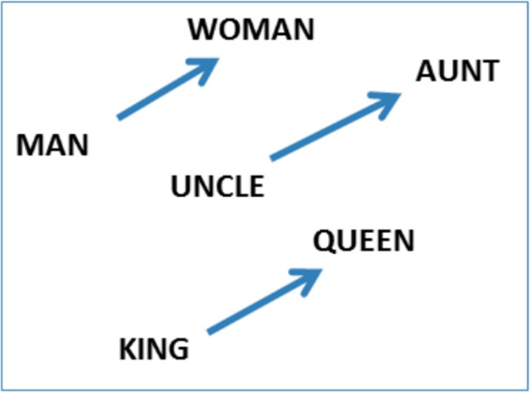
Vcctor Offset for Gender Relation
Word Embeddings - Part I
Week 7, Lecture 4
11 / 19

Slide 56
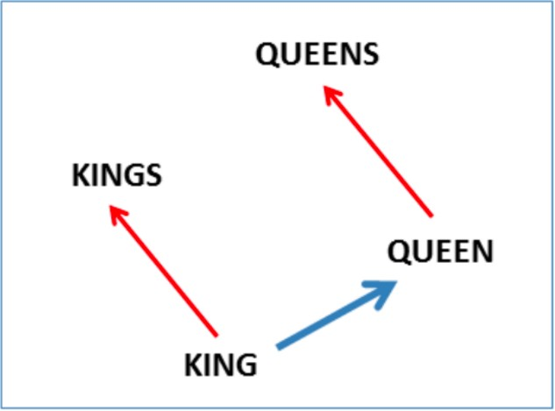
Vcctor Offset for Singular-Plural Relation
Word Embeddings - Part I
Week 7, Lecture 4
12 / 19

Slide 57
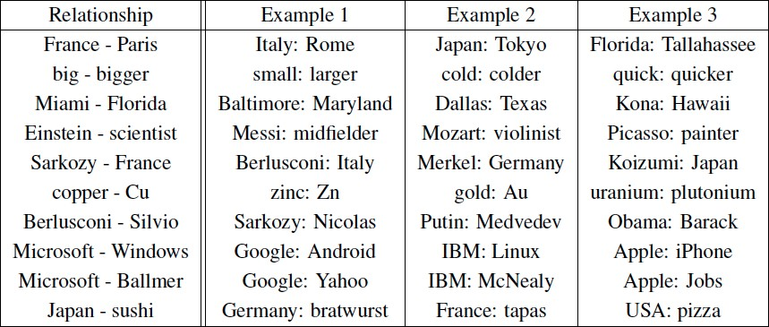
Encoding Other Dimensions of Similarity
Analogy Testing
Word Embeddings - Part I
Week 7, Lecture 4
13 / 19

Slide 58
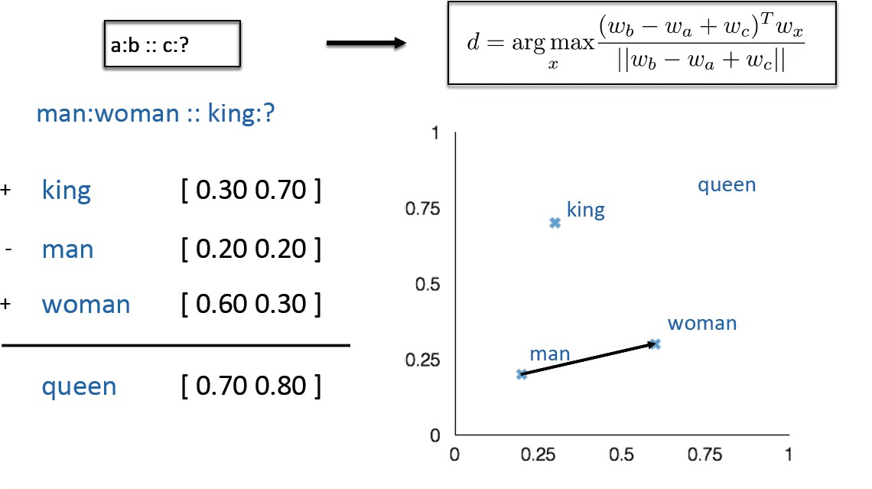
Analogy Testing
Word Embeddings - Part I
Week 7, Lecture 4
14 / 19

Slide 59
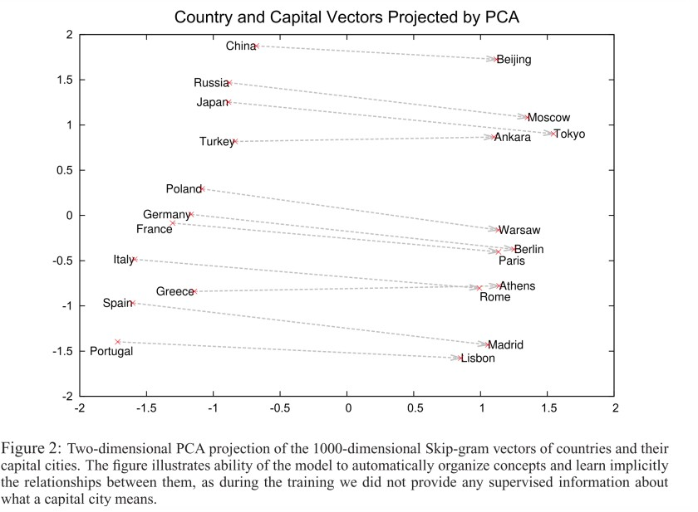
Country-capital city relationships
Word Embeddings - Part I
Week 7, Lecture 4
15 / 19

Slide 60
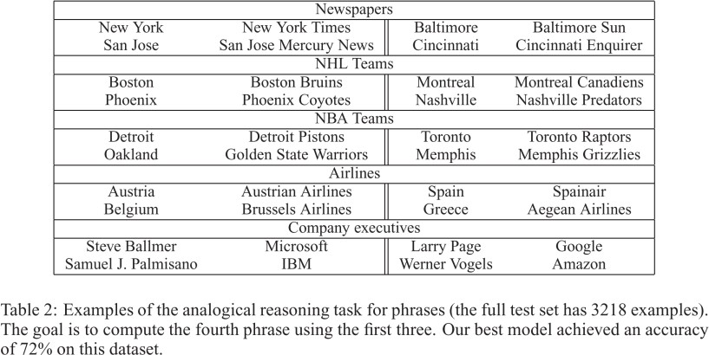
More Analogy Questions
Word Embeddings - Part I
Week 7, Lecture 4
16 / 19

Slide 61
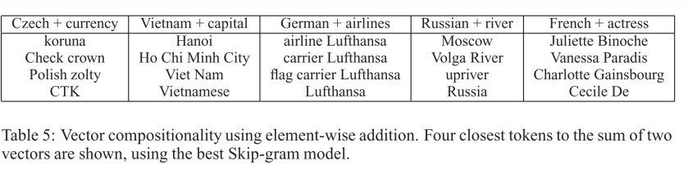
Element Wise Addition
We can also use element-wise addition of vector elements to ask questions such as ‘German + airlines’ and by looking at the closest tokens to the composite vector come up with impressive answers:
Word Embeddings - Part I
Week 7, Lecture 4
17 / 19

Slide 62
Learning Word Vectors
Basic Idea
Instead of capturing co-occurrence counts directly, predict (using) surrounding words of every word.
Code as well as word-vectors: https://code.google.com/p/word2vec/
Word Embeddings - Part I
Week 7, Lecture 4
18 / 19

Slide 63
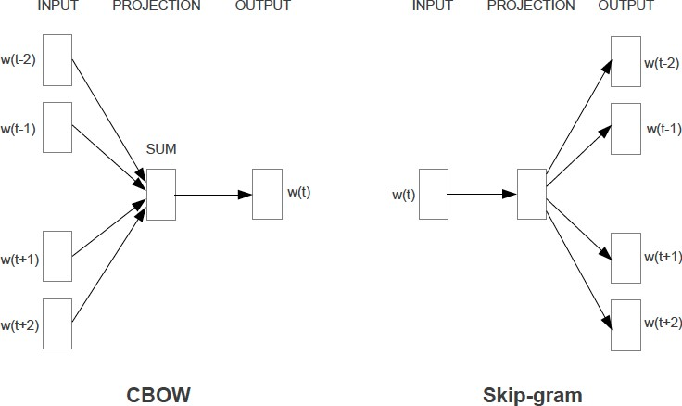
Two Variations: CBOW and Skip-grams
Word Embeddings - Part I
Week 7, Lecture 4
19 / 19

Slide 64
Word Embedings - Part II
Pawan Goyal
CSE, IIT Kharagpur
Week 7, Lecture 5
Word Embedings - Part II
Week 7, Lecture 5

Slide 65
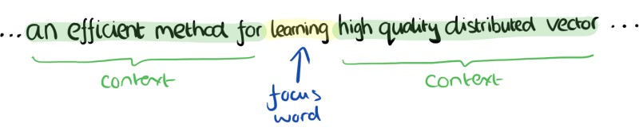
CBOW
Consider a piece of prose such as:
“The recently introduced continuous Skip-gram model is an efficient method for learning high-quality distributed vector representations that capture a large number of syntatic and semantic word relationships.”
Imagine a sliding window over the text, that includes the central word currently in focus, together with the four words that precede it, and the four words that follow it:
Word Embedings - Part II
Week 7, Lecture 5
2 / 14

Slide 66
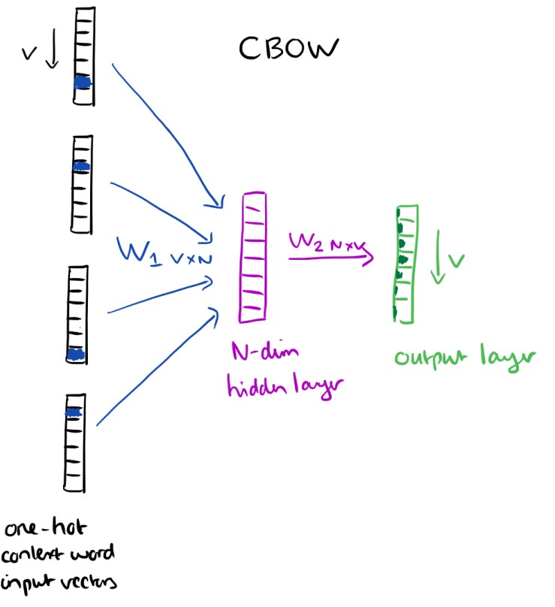
CBOW
The context words form the input layer. Each word is encoded in one-hot form. A single hidden and output layer.
Word Embedings - Part II
Week 7, Lecture 5

Slide 67
CBOW: Training Objective
The training objective is to maximize the conditional probability of observing the actual output word (the focus word) given the input context words, with regard to the weights.
In our example, given the input (“an”, “efficient”, “method”, “for”, “high”, “quality”, “distributed”, “vector”), we want to maximize the probability of getting “learning” as the output.
Word Embedings - Part II
Week 7, Lecture 5

Slide 68
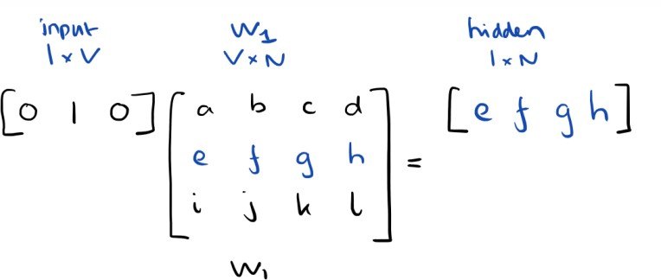
CBOW: Input to Hidden Layer
Since our input vectors are one-hot, multiplying an input vector by the weight matrix W₁ amounts to simply selecting a row from W₁.
Given C input word vectors, the activation function for the hidden layer h amounts to simply summing the corresponding ‘hot’ rows in W₁, and dividing by C to take their average.
Word Embedings - Part II
Week 7, Lecture 5

Slide 69
CBOW: Hidden to Output Layer
From the hidden layer to the output layer, the second weight matrix W₂ can be used to compute a score for each word in the vocabulary, and softmax can be used to obtain the posterior distribution of words.
Word Embedings - Part II
Week 7, Lecture 5

Slide 70
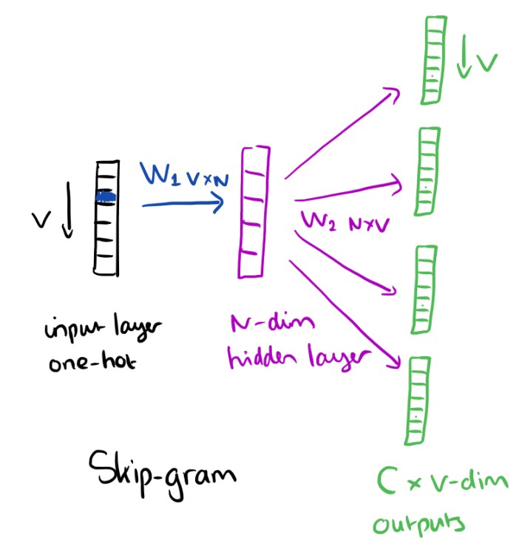
Skip-gram Model
The skip-gram model is the opposite of the CBOW model. It is constructed with the focus word as the single input vector, and the target context words are now at the output layer:
Word Embedings - Part II
Week 7, Lecture 5

Slide 71
Skip-gram Model: Training
The activation function for the hidden layer simply amounts to copying the corresponding row from the weights matrix W₁ (linear) as we saw before. At the output layer, we now output C multinomial distributions instead of
just one.
The training objective is to mimimize the summed prediction error across all context words in the output layer. In our example, the input would be “learning”, and we hope to see (“an”, “efficient”, “method”, “for”, “high”, “quality”, “distributed”, “vector”) at the output layer.
Word Embedings - Part II
Week 7, Lecture 5

Slide 72
Skip-gram Model
Details
Predict surrounding words in a window of length c of each word
Objective Function: Maximize the log probablility of any context word given the current center word:
1
T
J(θ) = _{T} ∑
∑
log p(w_{t+j}|w_{t})
t=1 −c≤j≤c,j=/ 0
Word Embedings - Part II
Week 7, Lecture 5
9 / 14

Slide 73
Word Vectors
For p(w_{t+j}|w_{t}) the simplest first formulation is
exp(v′_{wO}^{T} v_{WI} )
p(w |w ) =
O I
∑
W
exp(v^{′ T}v_{WI} )
w=1 w
where v and v′ are “input” and “output” vector representations of w (so every word has two vectors)
Word Embedings - Part II
Week 7, Lecture 5
10 / 14

Slide 74
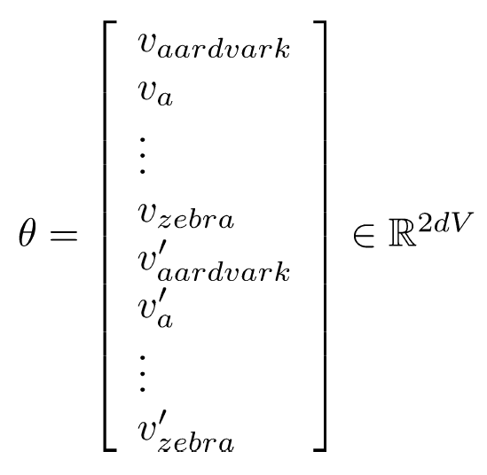
Parameters θ
With d−dimensional words and V many words:
Word Embedings - Part II
Week 7, Lecture 5
11 / 14

Slide 75
Gradient Descent for Parameter Updates
∂
_{∂θj}old
new old
θ = θ −α
J(θ)
j j
Word Embedings - Part II
Week 7, Lecture 5
12 / 14

Slide 76
Two sets of vectors
Best solution is to sum these up
L_{final} = L + L′
A good tutorial to understand parameter learning:
https://arxiv.org/pdf/1411.2738.pdf
An interactive Demo
https://ronxin.github.io/wevi/
Word Embedings - Part II
Week 7, Lecture 5
13 / 14

Slide 77
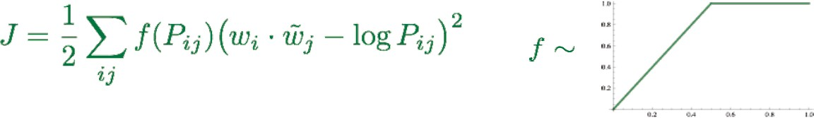
Glove
Combine the best of both worlds – count based methods as well as direct prediction methods
Fast training
Scalable to huge corpora
Good performance even with small corpus, and small vectors
Code and vectors: http://nlp.stanford.edu/projects/glove/
Word Embedings - Part II
Week 7, Lecture 5
14 / 14

